Slide 1
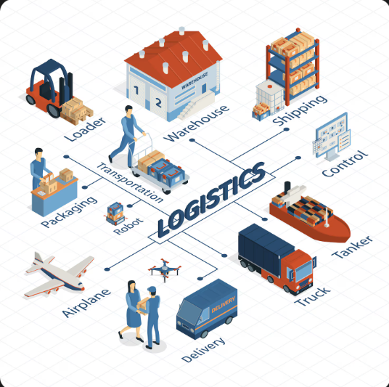
Global Supply Chain Performance Intelligence
End to End Analytics Using Python, MySQL & Power BI

Slide 2
Executive Summary
Total Shipments
Total Revenue
OTIF Performance
~10,000
$1.40B
45.17% (vs 95% benchmark)
Avg Transit Time
Avg Transport Cost
Profit Margin
6.02 days
$5.5 per KM
70%
Supplier Lead Time
11.22 days

Slide 3
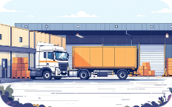
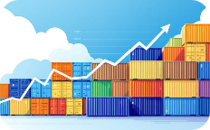
Business Problem
Low On Time Delivery
Rising Logistics Cost Risk
Failure to meet delivery expectations across the network.
Transport cost per KM pressures margins as volumes shift.

Slide 4
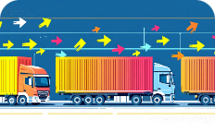

Business Problem
Supplier Lead Time Variability
Limited Operational Visibility
Inconsistent vendor performance increases uncertainty.
Hard to act proactively without consolidated analytics.

Slide 5

Project Objective
End-to-End Analytics
Build a scalable supply chain analytics solution.
Monitor Delivery
Track OTIF and transit performance in real time.
Track Cost Efficiency
Measure cost per KM and optimize spend.
Evaluate Suppliers
Assess lead times and reliability for vendor decisions.
Enable Decisions
Provide actionable insights for operations and strategy.

Slide 6
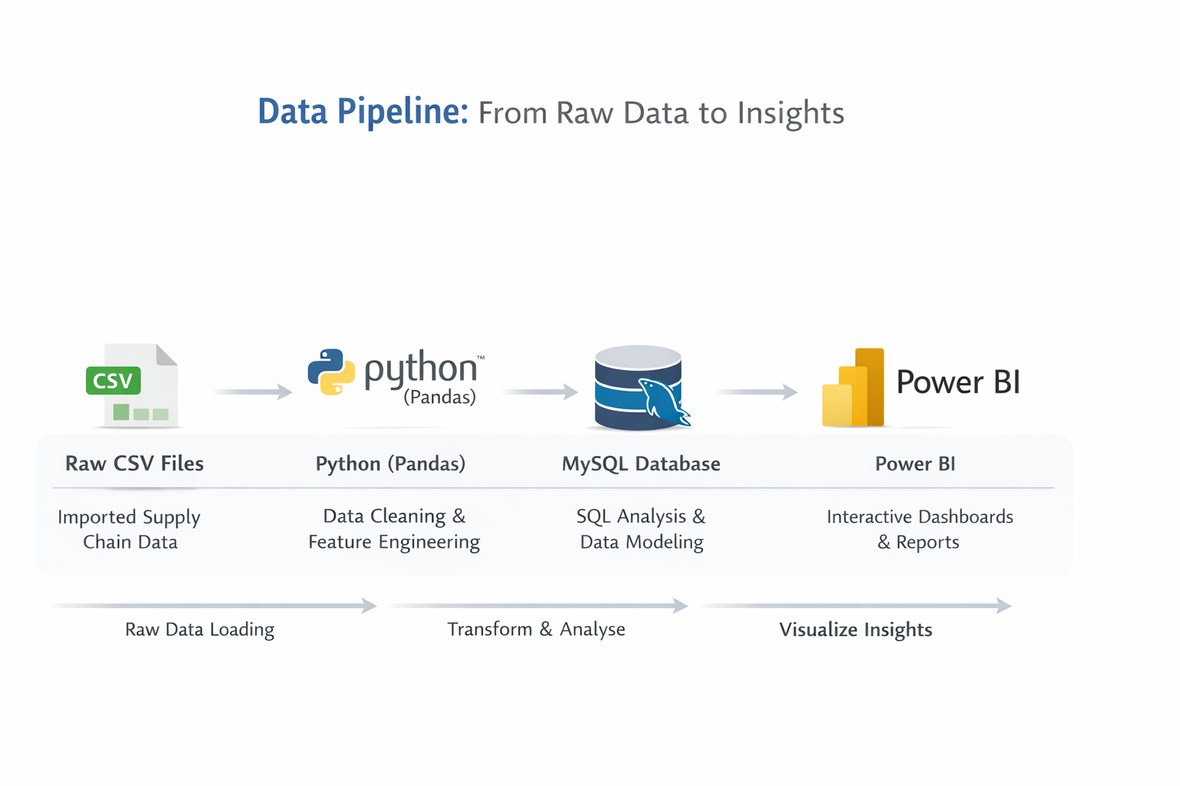

Slide 7
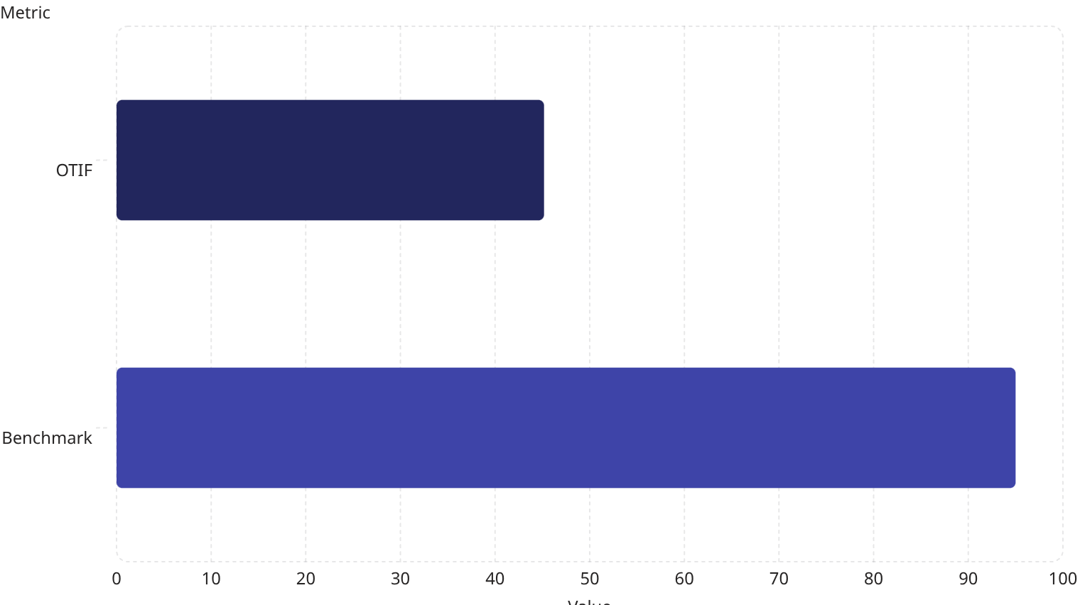
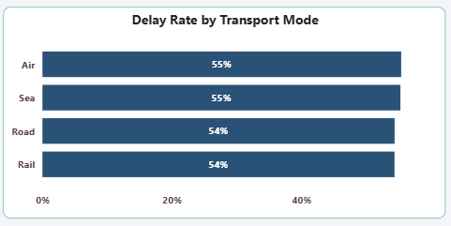
Key Insights
OTIF & Delay Risk
OTIF at 45.17% versus 95% benchmark. Major business risk: customer dissatisfaction and service failure.
Delays are network-wide Air, Sea, Road, and Rail show similar risk. Recommendation: focus on reliability improvements across carriers and routes.

Slide 8
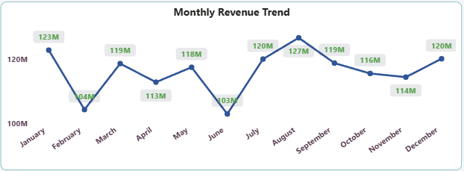
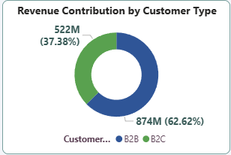
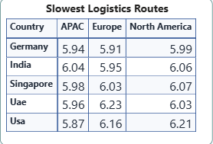
Routes, Revenue & Customer Mix
Slowest Routes
Revenue Performance
Customer Mix
North America slightly slower than APAC & Europe — route optimization needed as volumes grow.
Stable monthly revenue. Lowest: Feb (~104M), Jun (~103M). Peak: Aug (~127M).
B2B ~62.6% | B2C ~37.4 heavy B2B dependency suggests diversification.

Slide 9
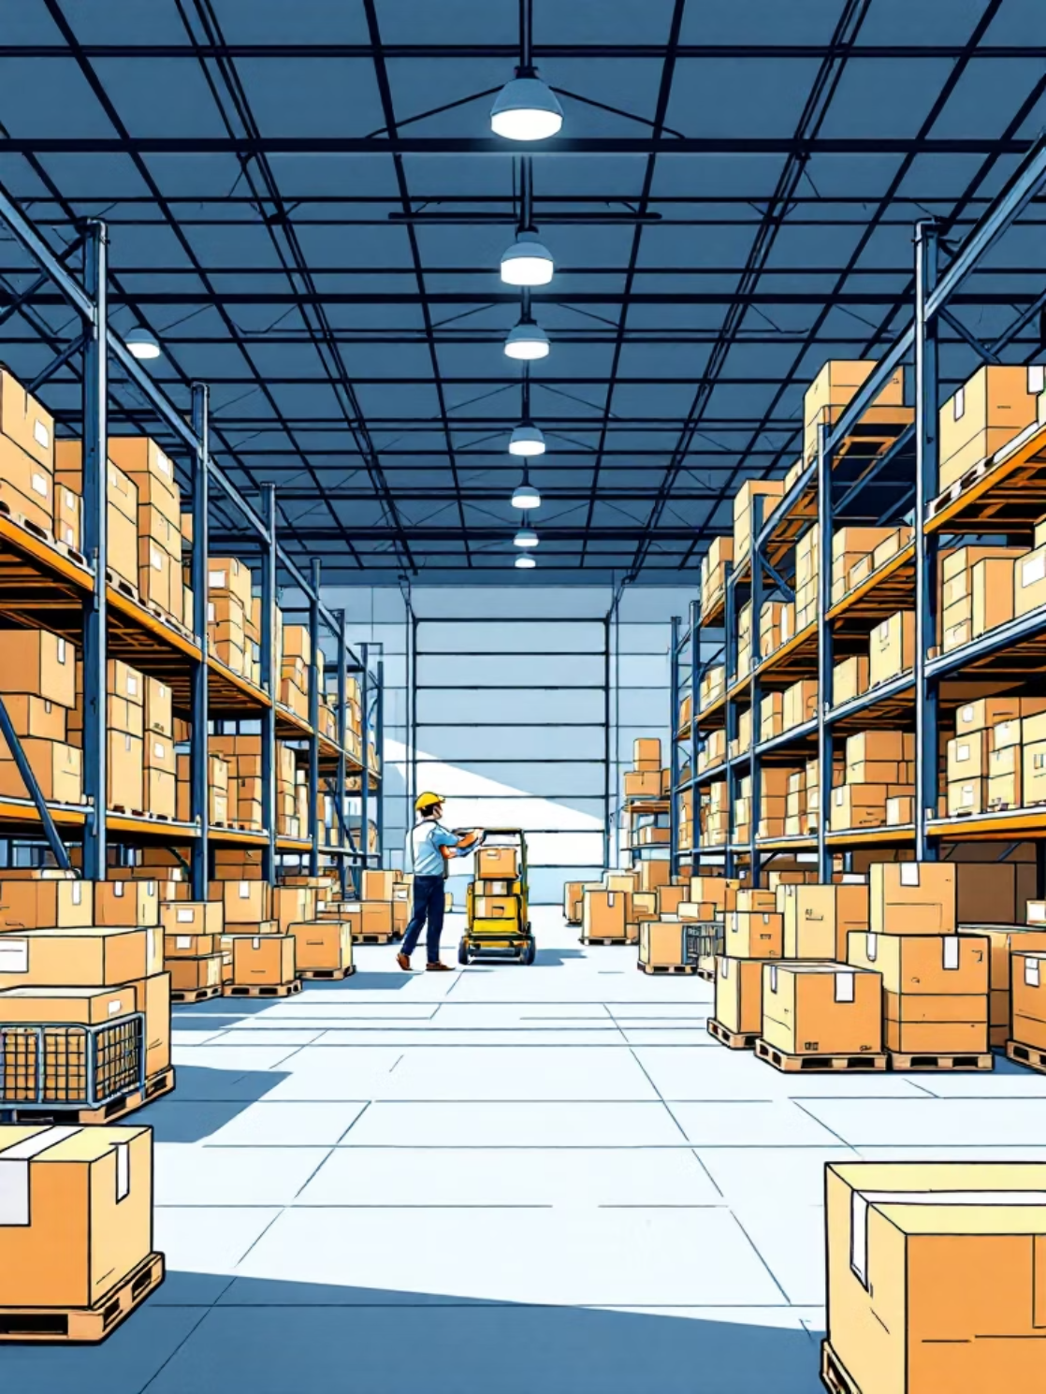
Supplier & Profitability Health
Supplier Performance
Avg lead time: 11.22 days. Moderate efficiency with vendor variability risk.
Profitability
Profit margin ~70%. Logistics cost appears controlled but requires continuous monitoring.

Slide 10
Recommendations
01
Improve OTIF to 90%+
Prioritize reliability initiatives and carrier accountability.
02
Optimize Routes & Carriers
Route-level optimization to reduce transit time and cost per KM.
03
Strengthen Supplier Scorecard
Standardize vendor metrics and act on variability.
04
Diversify Customer Mix & Monitor KPIs
Grow B2C and continuously monitor cost and margins via dashboards.

